Slide 1


Adult Census Income Prediction
PROJECT ARCHITECTURE
20.05.2023
─
Project By :
Niharika Malik

Slide 2
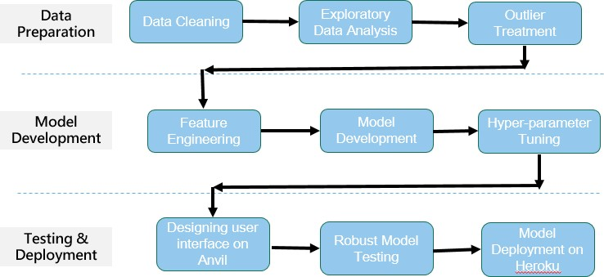
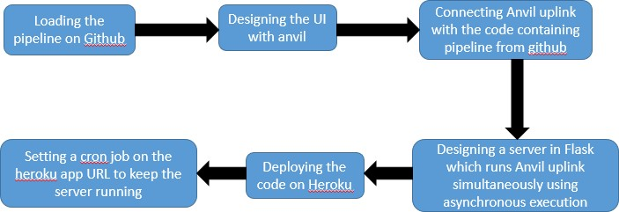
Architecture
Proposed Methodology
Deployment Process

Slide 3
Architecture Description
Data Description
The dataset named Adult Census Income is available in kaggle and UCI repository. This data was extracted from the 1994 census bureau dataset by Ronny Kohavi and Barry Becker (Data Mining and Visualization, Silicon Graphics). The prediction task is to determine whether a person makes over $50K a year or not.
Data Preparation
This step includes all the necessary steps that take place in the life cycle of a data science project namely, Data cleaning, Exploratory Data Analysis (EDA), and outlier treatment. In this step, our data gets prepared to be feeded to our ML model.
Model Development
This step contains all other necessary steps such as Feature Engineering, Feature Selection, Model Selection and Hyperparameter tuning to make the best possible model that can be made for accurate and correct prediction.
Deployment Process
In this step, we first develop the UI using Anvil and connect with our code in which our model is running with the help of an uplink and create a server using Flask which runs the uplink code (server code) using parallel excecution or asynchronous execution and we will then upload the hole code in Heroku cloud using git and github. We will then set a cron job on that server to keep the server and server code running forever.

